Slide 1


Data Structures and Algorithms 1 Lab
Project Presentation
“ A 2D Juggling game using C++ and Raylib”
Submitted to:
Submitted by:
Teacher’s Name | Designation
Saima Siddique Tashfia | Lecturer
Sadia Afrin Urmi | Lecturer
Student’s Name | ID
Gaus Saraf Murady | 0432410005101088

Slide 2
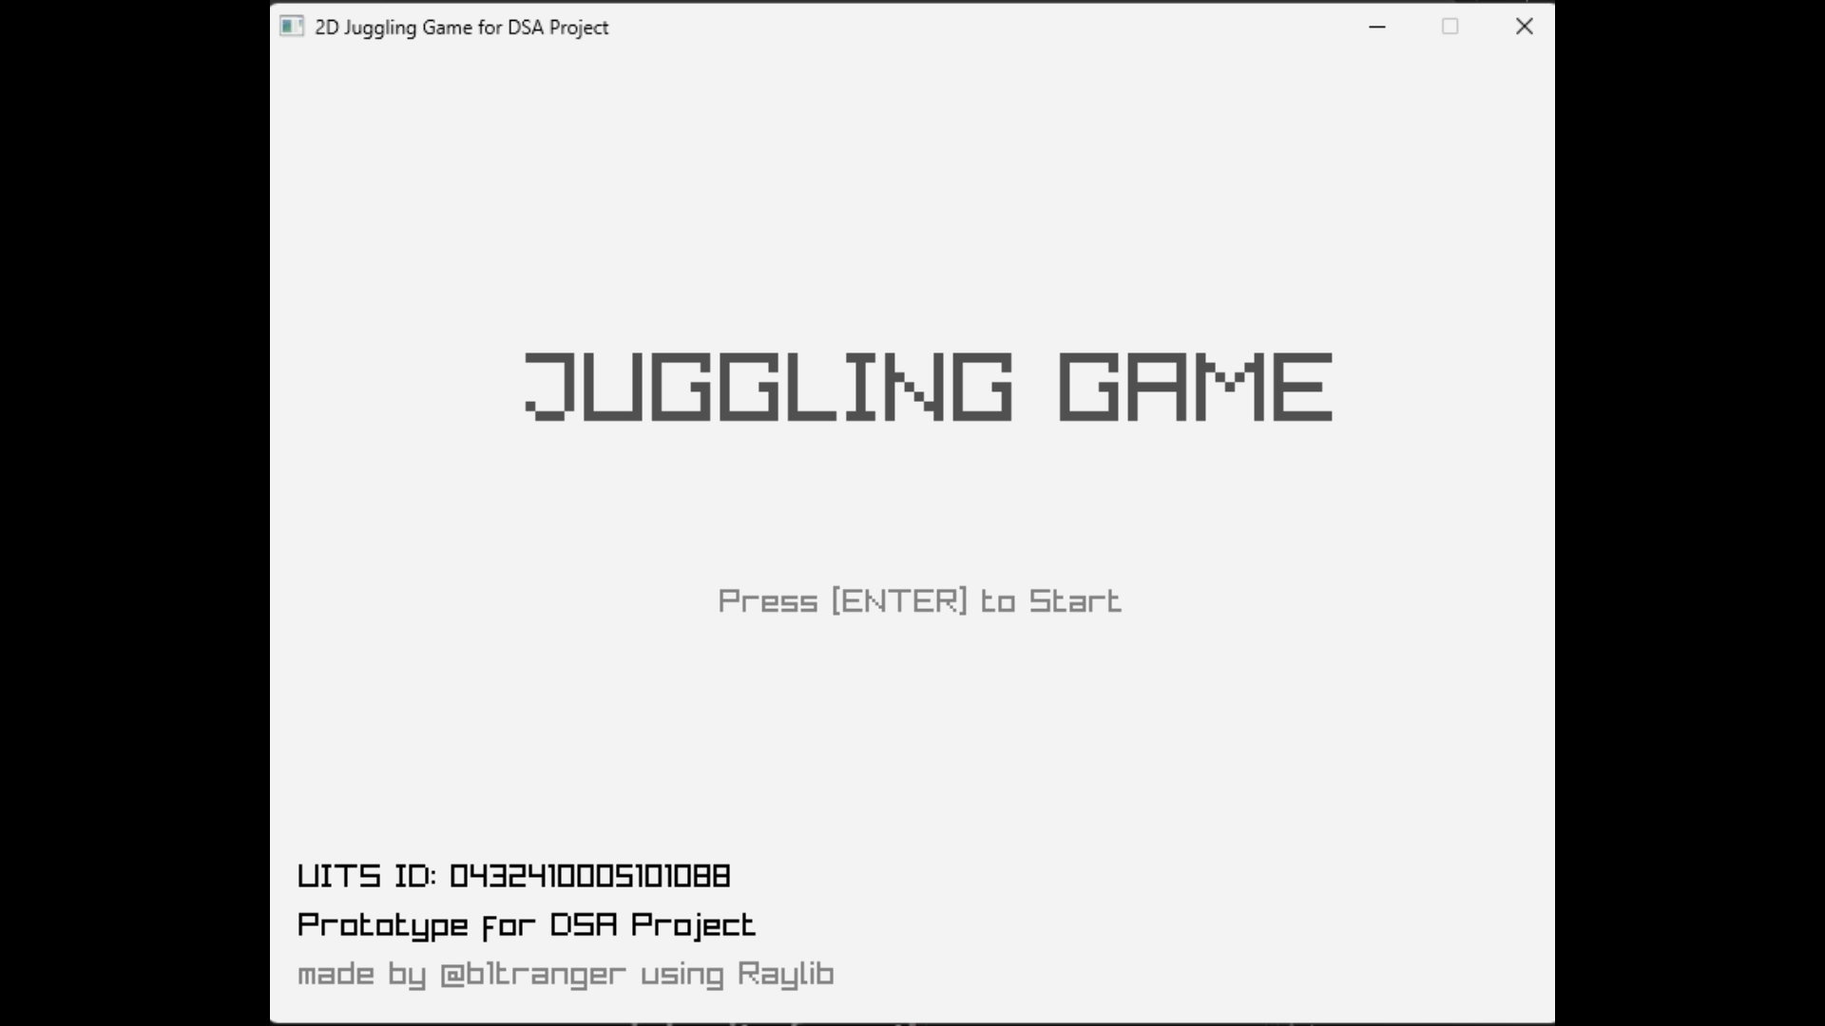

Slide 3
# Tools used for this project:
Visual Studio 2022
GitHub (for versioning)
YouTube (for tutorials)
Ralib Framework
ChatGPT (for debugging and documentation)

Slide 4
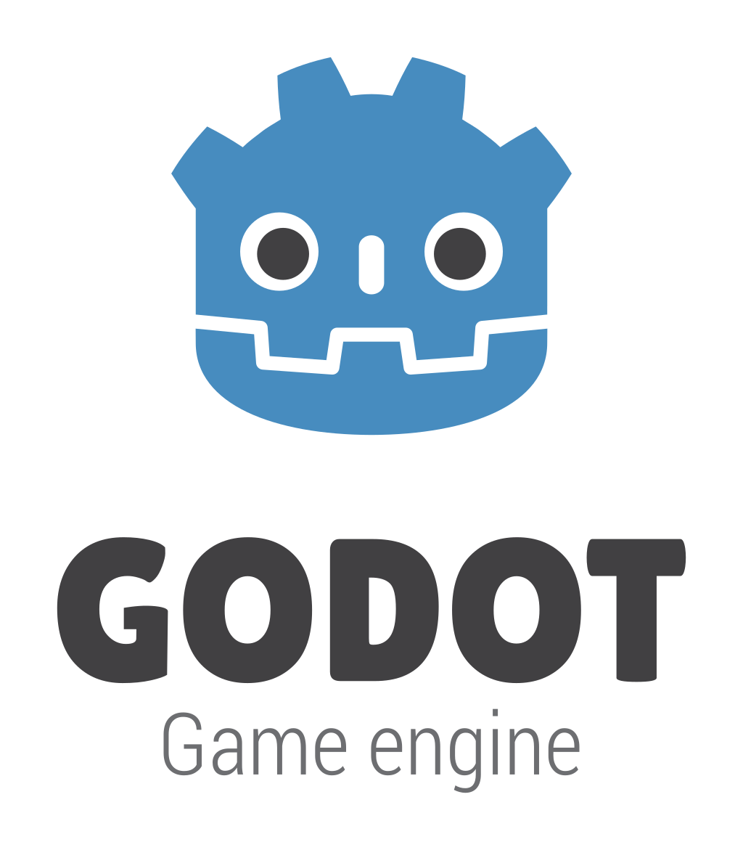




# Some popular Game Engines:
👑
(this crown is just an emoji)

Slide 5
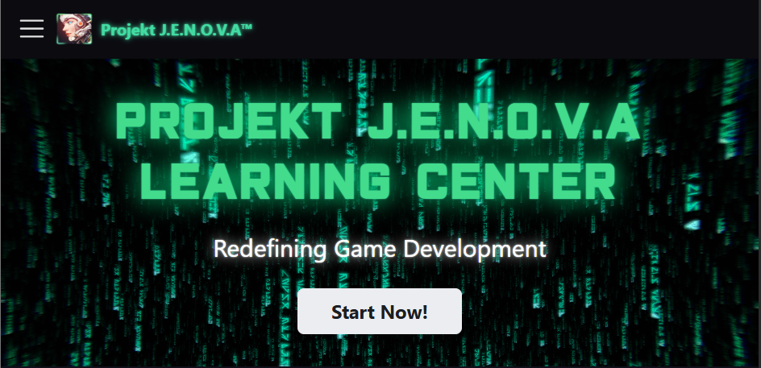
“Projekt J.E.N.O.V.A is a comprehensive series of extension libraries for the Godot 4 Game Engine expanding its capabilities with cutting-edge technologies”
- PROJEKT JENOVA @ GitHub

Slide 6
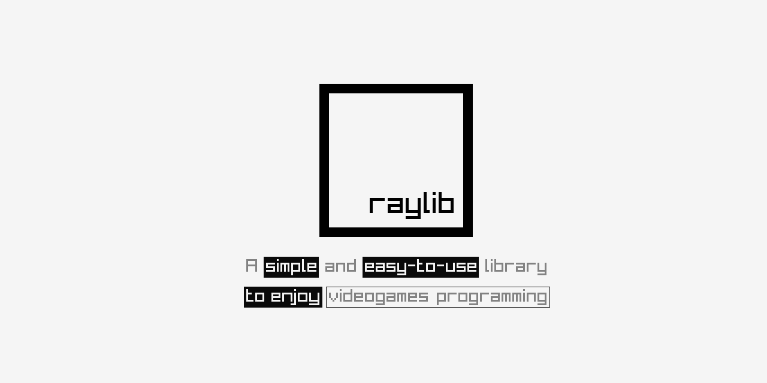
“raylib is a simple and easy-to-use library to enjoy videogames programming.”
- www.raylib.com

Slide 7
# Code and Screenshots of the Project

Slide 8
# Main Menu / Title Screen:

Slide 9
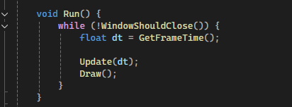
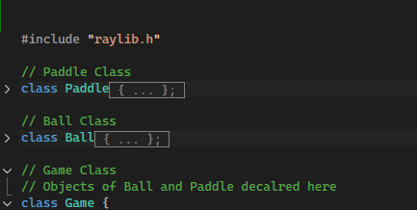
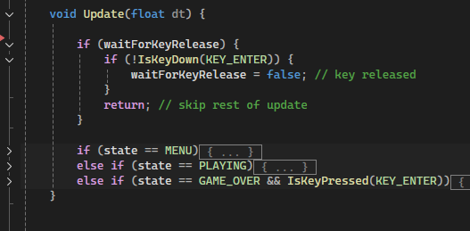
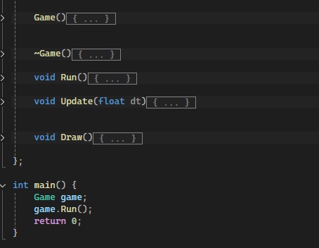
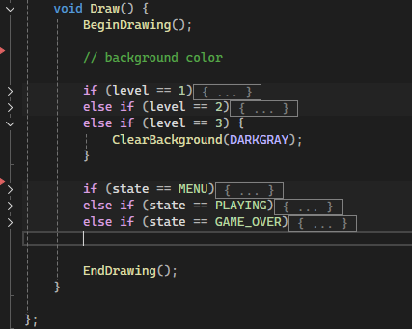
# Code:
Game Loop
Classes and Main Function:
Generates Menu Screen

Slide 10
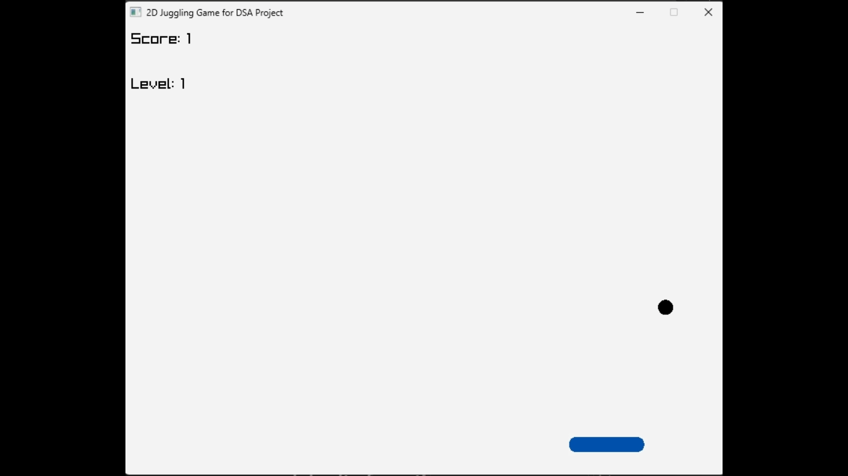
# Game Window:

Slide 11
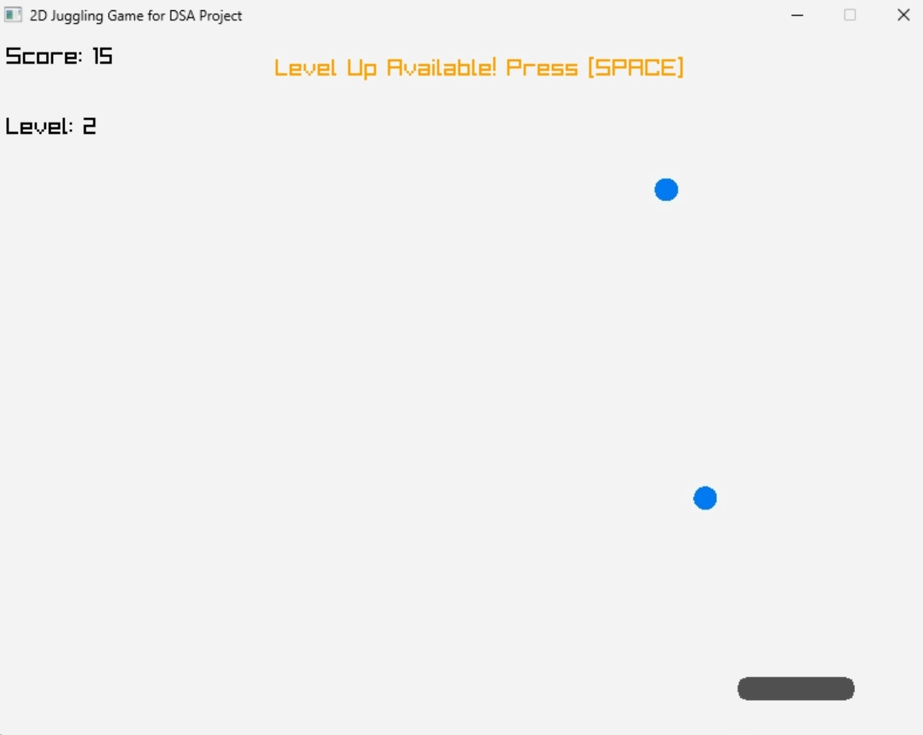
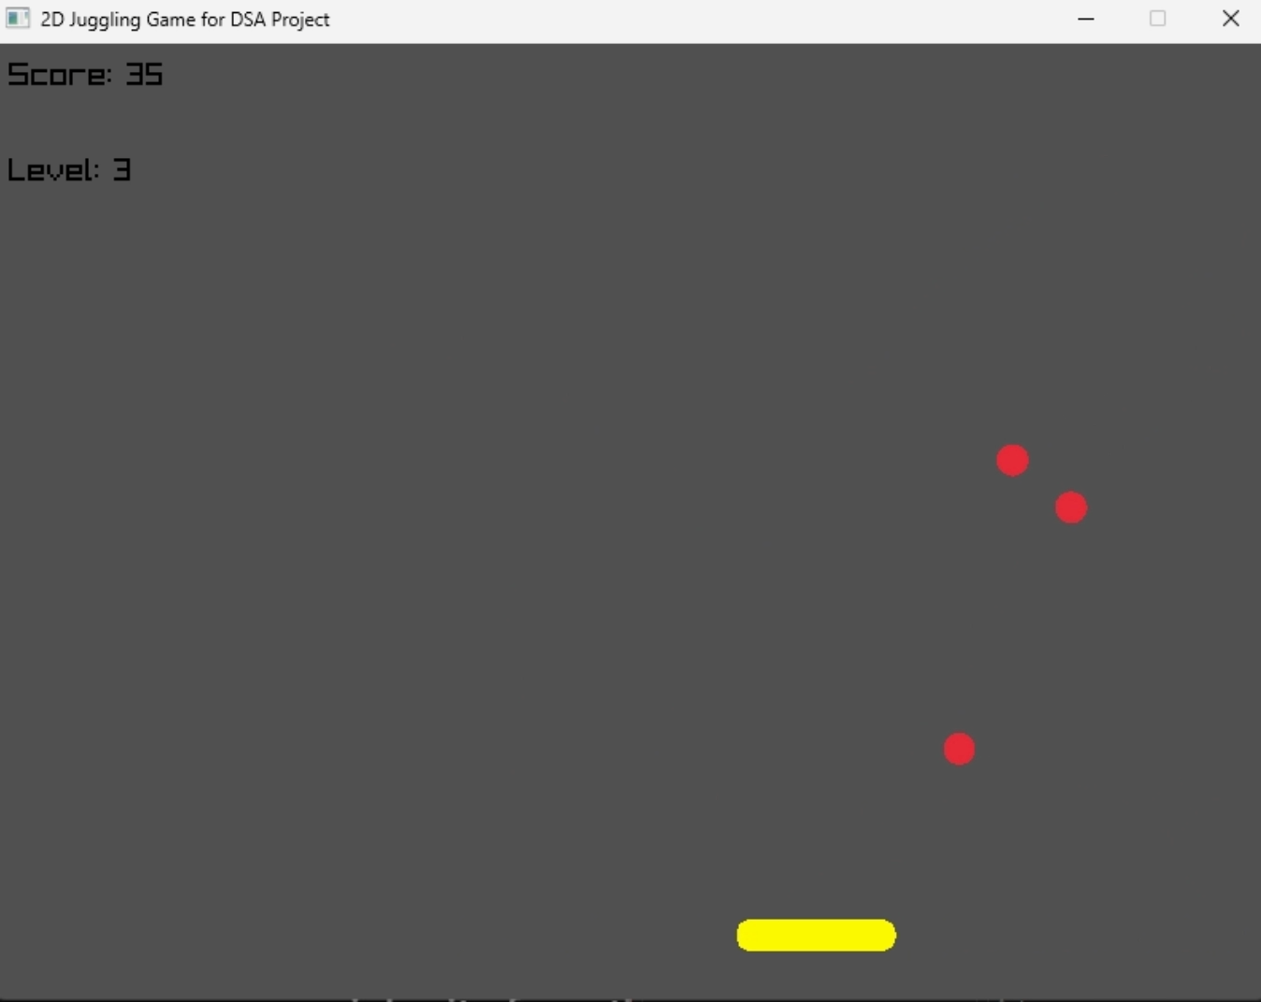
# Level Mechanisms:

Slide 12
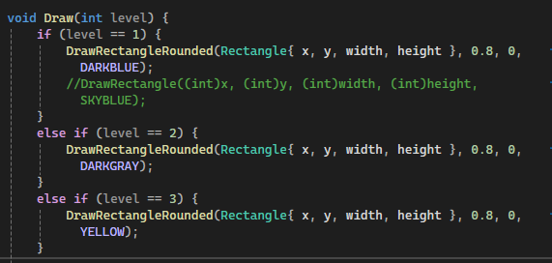
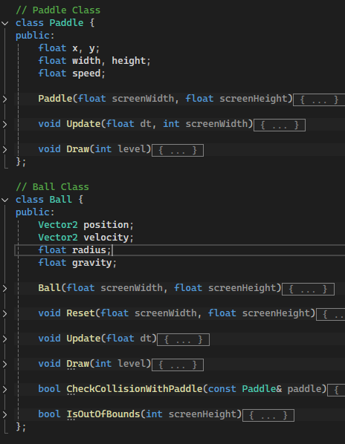
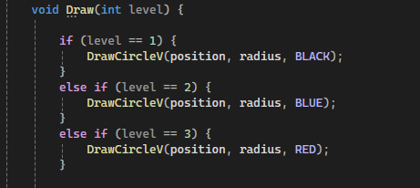
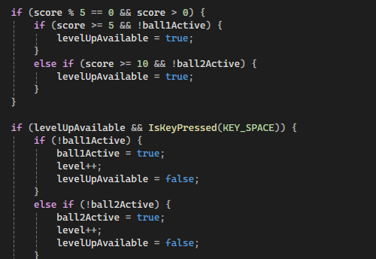
# Code:
Paddle and Ball Classes:
Level based theme
Level Up Logic

Slide 13
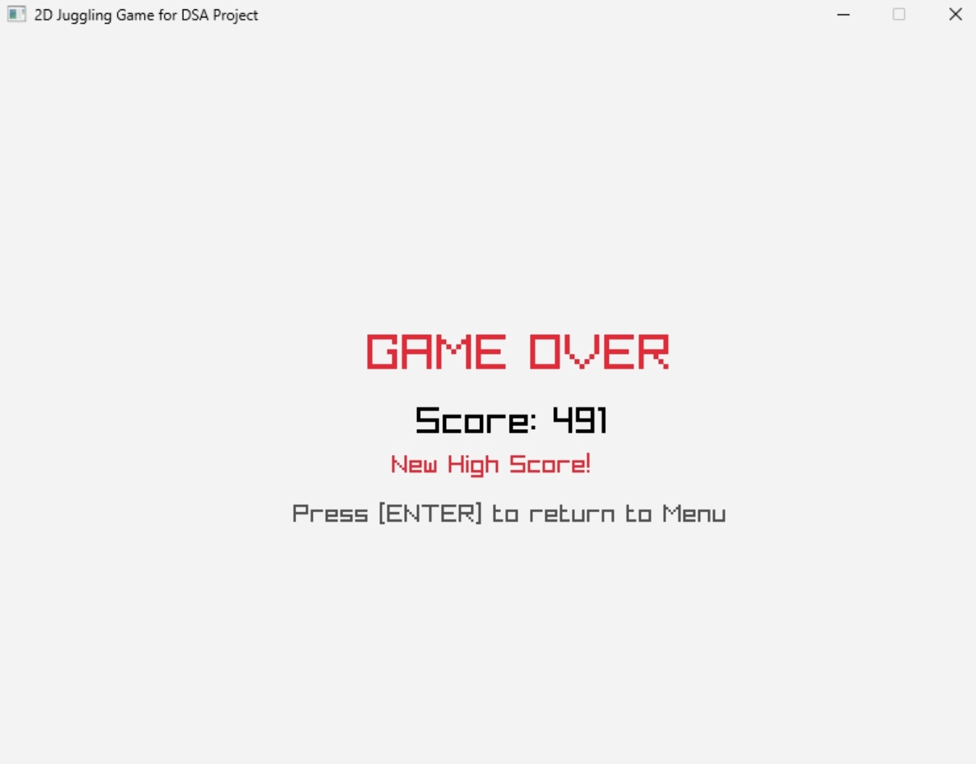
# End Game Window:

Slide 14
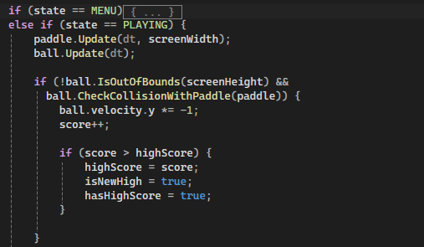
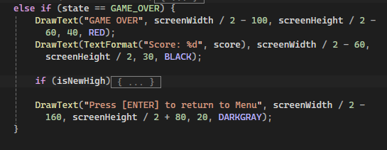
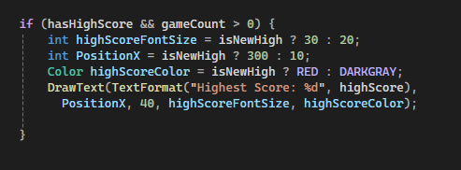
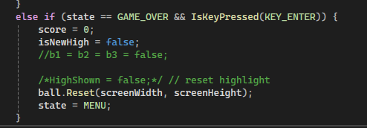
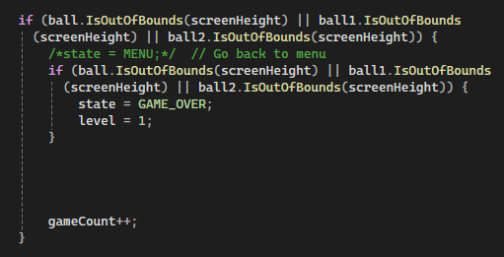
# Code:
End Game Screen Generation:
Scoring and High Score
Reset Score, keep Highest Score:
New High Score
Game Over Logic

Slide 15
Demo Gameplay

Slide 16
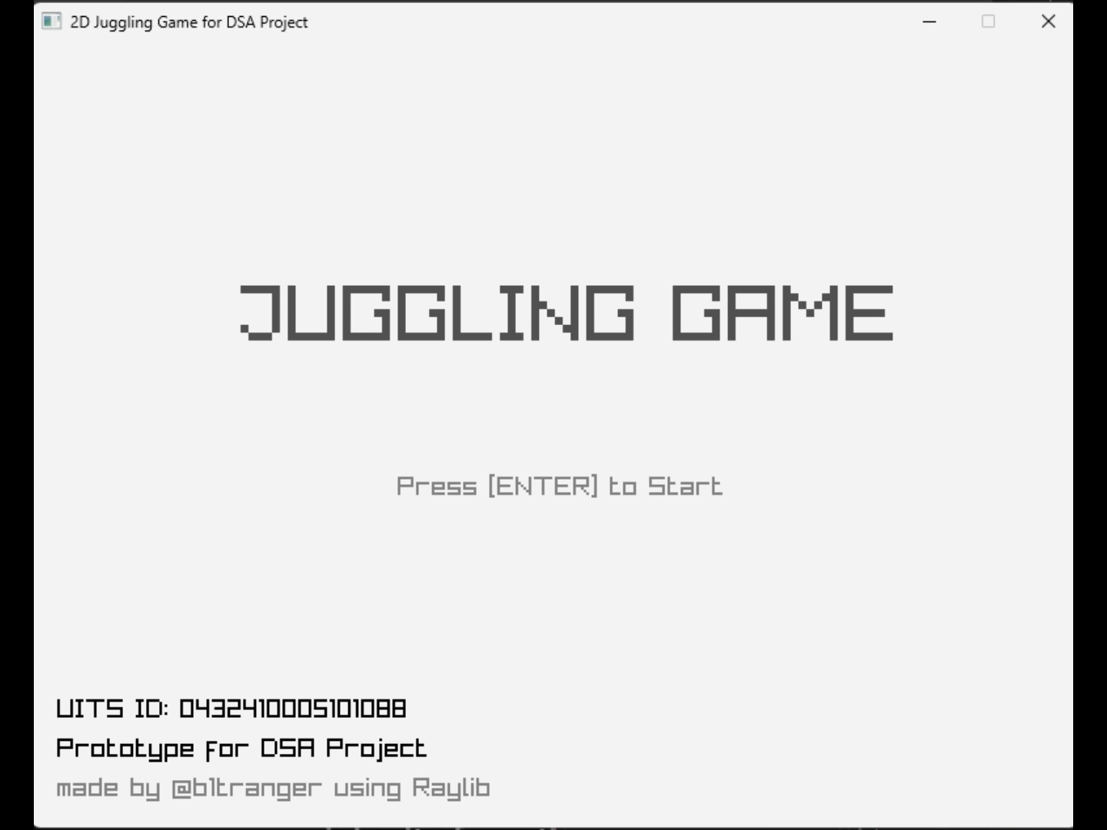

Slide 17
Thank You
I need sleep

